Slide 1
Functions
CSCI291 Programming for Engineers
I. Standard math functions
II. User defined functions
III. Scope
IV. Case studies
V. Common Errors
Acknowledgment: These slides are based on Dr Obada Al Khatib’s ones.

Slide 2
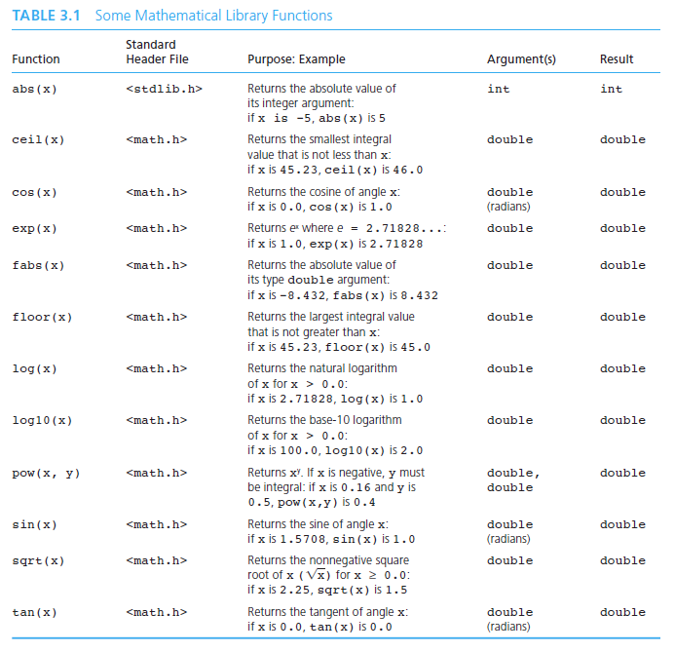
I. Standard math functions
Function identifier (name)
pow(
x, y);
function parameters
Data type of the returned value

Slide 3
Standard math functions
If you need to use a math function, the math library must be linked to your program as follows:
#include <math.h>
When you call a function, replace its formal parameters with the actual parameters in your program: constants, variables, or expressions
#include <stdio.h>
#include <math.h>
#define PI 3.1415926 int main(void)
{
double signal, f=30.0,
sin( x )
x is a formal parameter indicating that sin() requires one actual parameter
t=1.0;
Actual function parameters
Or arguments
signal = 5.0*sin( 1.5 );
…. singal
…
= 10.0*sin( 2.0*PI*f*t );
}

Slide 4
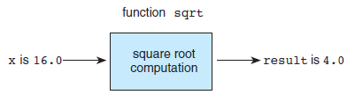
Function sqrt(..) as a “Black Box”
The sqrt() function is a library function computes the square root of a number.
To use include <math.h> in your program
Function prototype:
double sqrt(double arg);

Slide 5
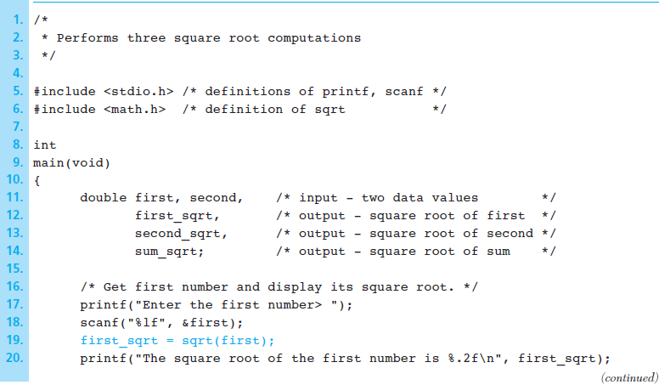
A sqrt(..) based Program

Slide 6
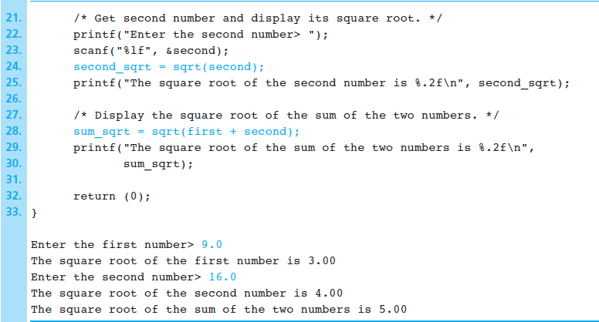
…Continued

Slide 7
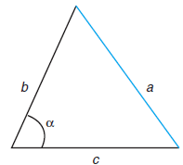
Example
Give the C expression to calculate the value of the side a in the triangle below
Answer:
a = sqrt(pow(b,2) + pow(c,2) - 2 * b * c * cos(alpha * PI / 180.0));
Angle must be in radian, see slide 6
Notes:
Triangle with Unknown Side a

Slide 8
II. User defined functions
Implement a function
Make decision about data input
what values (if any) need to be passed to the function
Example: two values of type int
what value (if any) is returned by the function
Example: a value of type int
Choose a meaningful name for the function
Example: findMaxValue
1.1 Provide the function prototype
Example: int findMaxValue( int
val1,
int val2);
1.2 Provide the function definition
Example: int findMaxValue( int
{ . . . .
}
val1,
int val2)

Slide 9
User defined functions
Use a function
Call the function by specifying its name and passing the values (if required)
Example: printTime( hours, minutes );
If the function returns a value, you can assign it to a variable
Examples: | maxvalue | = findMaxValue( 15, | 94 | );
 | number = | getRandomNumber();

Slide 10
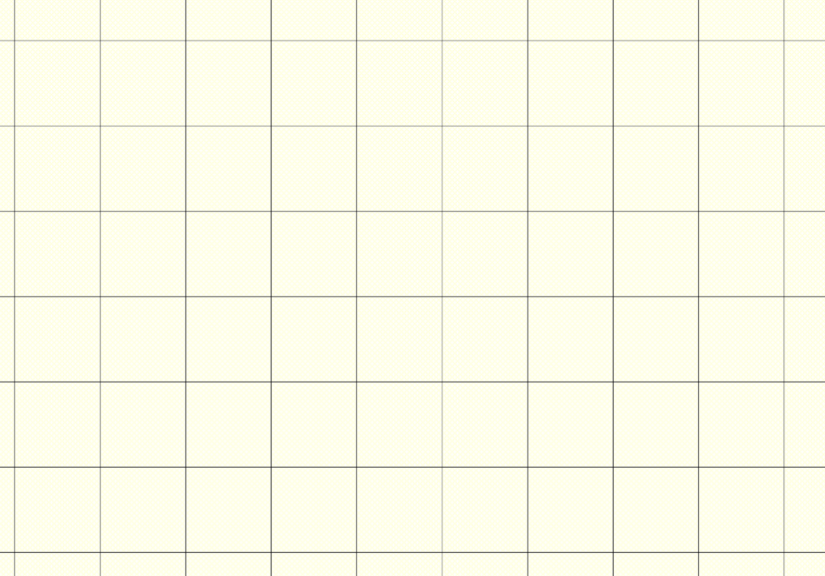
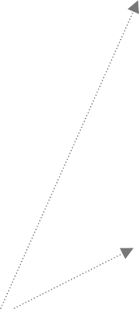


User defined function
/* preprocessor directives */
#include <stdio.h>
Prototype
/* Function prototypes */
float getDistance(float velocity,
. . .
float
theta);
int main(void)
{
/* local variables */
…………
/* Calculate distance */
distance = getDistance( 250.0, 30.0 );
……
return (0);
Function call
}
Function Definition
/* Function Definitions */
float getDistance(float velocity, float
{
theta *= RADIANS_PER_DEGREE;
theta)
dist = velocity*velocity* sin(2.0*theta)/G;
This order is important
}
…………

Slide 11
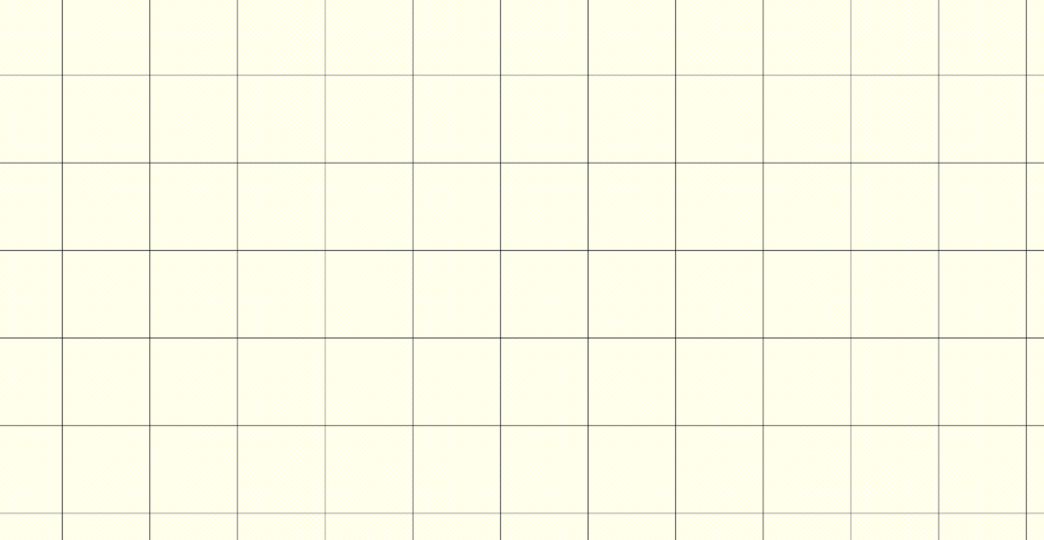
Function Definition
/* Function introductory comments */
return_type functionName( formal parameter
{
Function header
list )
/* local variable declarations */
. . . .
/* executable statements */
. . . .
Function body
return (expression);
}

Slide 12



Function return type
return_type functionName( formal parameter list )
{
. . . . .
}
Function return type has to be defined explicitly
– otherwise C assumes int
If function doesn’t return anything , use void as return type
Preferably, A return statement should be used even if the function return type is void (it doesn’t return a value)
int firstF(…)
{
int x;
x = … return x;
}
double secondF (…)
{
void thirdF (…)
{
…
…
return ;
}
double time = return
time;
… (2.0*time);
}

Slide 13

Formal parameter list
return_type functionName( formal parameter list )
{
. . . . .
}
The list contains parameters that will be assigned with actual values passed to the function when it is called. Parameters in the list are separated by commas
Each parameter must have a data type
If no parameters are passed to the function, always specify void
C assumes an empty parameter list ( ) as “unknown fixed number of parameters”.
return_type functionName (type par1, type par2, type par3) or
return_type functionName( void )
Examples:
int calcAverage(int x1, double getHeight(double char getSelection( char void prompt( void )
int x2)
velocity, double theta) lt, int index, int ptr )

Slide 14


Quiz
Find errors in the following function definitions
double multiply(
{
int z;
z = x*y + w; return z;
int x,
y);
getAverage( float x, float y);
{
float sum;
sum = x +y;
return (sum/2.0);
}
}
Missing data type for y
Variable w is not declared.
Semicolon at the end of the function header
CAUTION: Return type is double but z is int
No return type for the function, int will be assumed
Semicolon at the end of the function header
CAUTION: Return type is float

Slide 15


User defined function
 |  |  | Function Prototypes
 |  | calling
After the preprocessor directives
/* preprocessor directives */
………
/* Function prototypes */ double getDistance(double
…..
velocity,
double
theta);
int main(void)
{
/* local variables */
…………
Before the main() function
/* statements */
………
distance = getDistance(velocity, theta);
……. return 0;
}
/* Calculate distance */
double getDistance(double velocity, double theta)
{
theta *= RADIANS_PER_DEGREE;
return (velocity*velocity* sin(2.0*theta)/G);
}
…………
definition

Slide 16

Function prototypes
Syntax:
return_type functionName(type var1, …, type var3);
Examples:
#include <stdio.h>
. . . .
# define ALFA 5.67
. . . .
int average(int x,
/* header files needed for your
program */
/* definition
of constants */
int y);
Prototypes of all functions defined by you must be here
double calHeight(double velocity, char getSelection(void);
double theta);
int main (void)
{
…
return (expression)
}

Slide 17
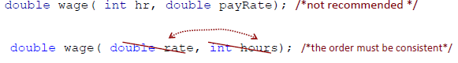
Function prototypes
Where:
A function prototype must appear before any call of the function
Syntax:
Assuming that you have defined a function
double wage(int hours, double rate)
{
return (hours*rate);
}
The prototype consists only of the function header (no code) and ends with ;
double wage( int hours, double rate);
C does not require identifiers in the parameter list, but it is easier to interpret the code if they are included
double wage( int, double ); /* possible, but not recommended */
Different parameter names from those in the function definition may be used (not recommended), but the order of the parameters in the declaration must match the parameter order in the definition

Slide 18
Quiz
Presuming the following definition
float process(int a, float b)
{
return (a+b);
}
Find errors in the following function prototypes
float float float float float
process(int process(int process(int
a, b);
a, int b); a);
Missing data type for b
Different data type for b
Missing parameter b
Different data types for both parameters
No errors
process(float b, int a); process(int a, float b);

Slide 19
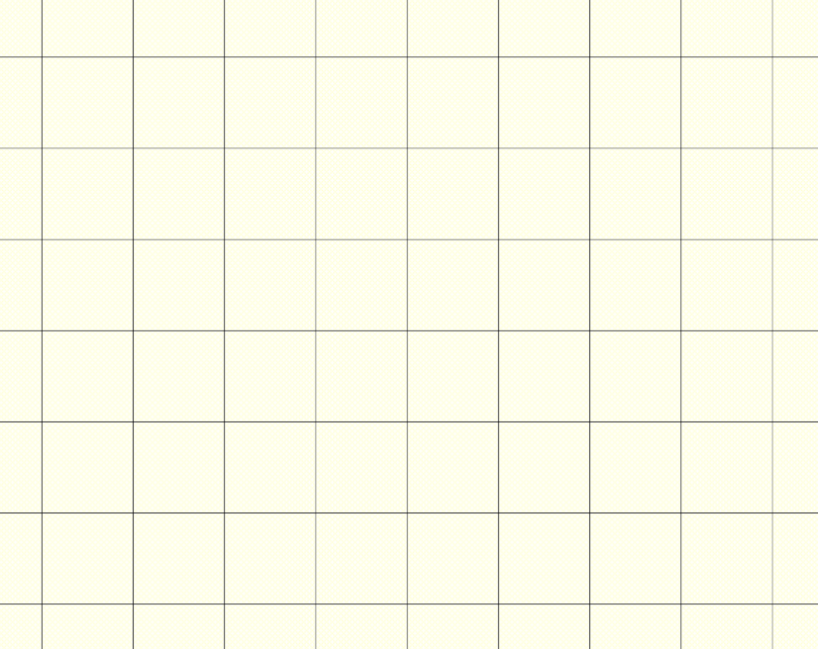

user defined function
 |  |  | prototypes
 |  | Function calls
/* preprocessor directives */
………
/* prototypes */
float getAverage(float a, float b);
…..
int main(void)
{
/* local variables */
double minPrice = 34.0; double maxPrice = 45.0;
/* executable statements */
………
distance = getAverage( minPrice,
……. return (0);
maxPrice );
}
/* Calculate distance */
float getAverage( float a, float b)
{
float average = (a + b)/2.0; return (average);
}
…………
definition

Slide 20
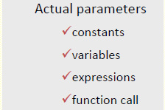

Function call
Syntax:
functionName(actual parameter list);
Examples:
int x=10, y=20, avg, prod;
. . . .
prompt(); /* no parameters */
Don’t specify data types of the actual parameters in function calls
avg = average( int x, int y | ); | /* two variables */
avg = average( x, y ); |  | /* two variables */
prod = product( 2, avg-3 ); |  | /* a constant and an expression */
avg = average( 15, prod ); |  | /* a constant and a variable */
avg = average( product( 2, | 3), | 8 ); /* a function and a constant */

Slide 21
Formal and Actual parameters
/* Function prototype */
int main(void)
{
double | findAverage(double | num1, | double | num2);
. . | . .
double | price1 = 10.00, | price2 | = | 20.00;
double | avgPrice;
Actual parameters
price1 and price2
/* Function call */ avgPrice = findAverage(
. . . . .
price1
, price2);
}
10.00
20.00
/* Function definition */
double findAverage(double
{
num1,
double
num2)
Formal parameters
num1 and num2
15.00
return ((num1+num2)/2.0) ;
}

Slide 22
Function call examples
#include <stdio.h>
int multiply(int x, int y);
.
int
{
/* function prototype */
. . . .
main( void )
int a, b = 6, product, result;
. . .
a = 5; /*
make sure that variables are initialized before in function calls */
they
are used
product = multiply(a, b);
printf(“a x b = %d \n”, product );
printf(“6 | x 7 = %d \n”, | multiply( 6, 7 ) );
. . .
product = | multiply(a+6, | b);
. . .
result = multiply( a/2, b ) + multiply( 6, b/3 );
product = multiply( multiply(a, b), a );
. . .
}

Slide 23
Quiz
Which function calls are incorrect?
int sum(int x, int y);
. . . .
int main (void)
{
int total, a=5, b=6, y;
y = sum( 10, 20 ); a = sum( a, b ) ,
int sum(int x, int y)
{
return (x+y);
}
incorrect
: missing ;
total = sum( total = sum( sum( a+b, 20
a+1, 20 );
int a, int 10 );
);
incorrect
incorrect
y = sum( 10+a );
total = sum( a, b ) + sum(
10, 20 );
return (0);
}

Slide 24
Void functions with parameters
#include <stdio.h> void printTwo(int x,
int y);
int main(void)
{
what are the values of a and b ?
int a=5, b=10;
a
b
printTwo(a, b); return 0;
}
values copied
void printTwo(int x, int y)
{
printf(“x=%d, y=%d!\n”, x,y); return;
what are the values of x and y after the function call?
x
y
}

Slide 25
Functions returning a value
#include <stdio.h> int sqr(int x); int main(void)
{
int a, b; scanf(“%d”, &a); b = sqr( a );
printf(“%d squared is %d\n”, a,b); return 0;
}
a
result
returned
and then assigned to b
value copied
int sqr(int x)
{
int result; result = x*x;
return result;
}
x

Slide 26
III. Scope
Global scope
Anything (constants, variables, functions, etc) defined in the global scope area is visible to the entire program
Global variables are placed in memory when the program is started and released from memory only when it is terminated
Local scope
Local scope variables are visible only within a function
Local automatic variables are placed in memory when the function is called and they are destroyed when the function returns
All subsequent function calls cannot retrieve values of local automatic variables from previous calls of the same function

Slide 27



/* this is a sample to
#include <stdio.h>
demonstrate scope */
Quiz
int fun(int a, int b);
global area
int main(void)
{
Automatic variable y is local to main()
int a, b, c; float y = 0.0;
main’s area
. . . y = 5.0;
c = fun(a, b);
/* OK */
/* OK */ ”, y );
printf( “ y = %f return 0;
y = ?
y is 5
}
Automatic variable
y is local to fun()
It’s different from the variable y declared in main()
int fun(int j,
{
int k)
fun’s area
int y;
y = 10;
return (y)
. . .
/* OK */
}

Slide 28
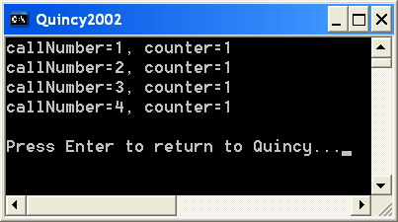

Static variables in functions
/* comments */
#include <stdio.h>
void function( void ); int main(void)
{
function(); function(); function(); function();
return (0);
}
/* function */ void function(
{
static int
value of a static variable is preserved between function calls
void )
callNumber = 0;
int counter=0; callNumber++; counter++;
printf(“callNumber=%d, counter=%d\n”, return;
Initialized only once
callNumber, counter);
}

Slide 29
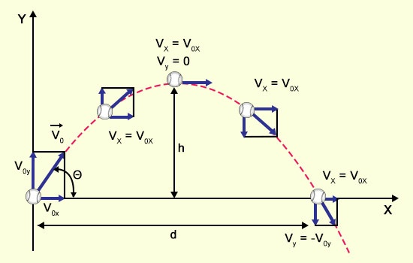
IV. Case study: Projectile Trajectory
A projectile fired at an angle θ with an initial velocity v₀
travels a distance d given by
d = sin(2*θ)* v_{o}²/g
where g is the acceleration constant of 9.8 m/sec²
It stays in motion for a time t given by
t = sin(θ)*2*v_{o}/g
and attains the maximum hight h given by
h = sin(θ)* v_{o}²/g

Slide 30
C Program with main() function only
#include <stdio.h>
#include <math.h>
#define | G | 9.8
#define | PI | 3.141592
#define RADIANS_PER_DEGREE
int main(void)
{
(PI/180)
float velocity, theta;
float distance, time, height;
scanf(“%f %f”, &velocity, &theta);
/* convert degrees to radians */ theta *= RADIANS_PER_DEGREE;
distance = velocity*velocity* sin(2.0*theta)/G;
time = 2.0*velocity*sin(theta)/G;
height = pow(velocity, 2.0)*sin(theta)/G;
printf(“distance = %f\n”, distance); printf(“time = %f\n”, time); printf(“height = %f\n”, height);
return (0);
}

Slide 31
Single‐ module Solution
Looks simple, but what if you need to calculate the distance, time and height several times with various parameters?

Slide 32
Task decomposition
main
input velocity & theta
output results
scanf(…)
calculate distance
calculate time
calculate height
printf(…)
Implement these modules as functions
To implement a function you need to consider:
function data input
an algorithm that is needed to produce the result
function data output

Slide 33
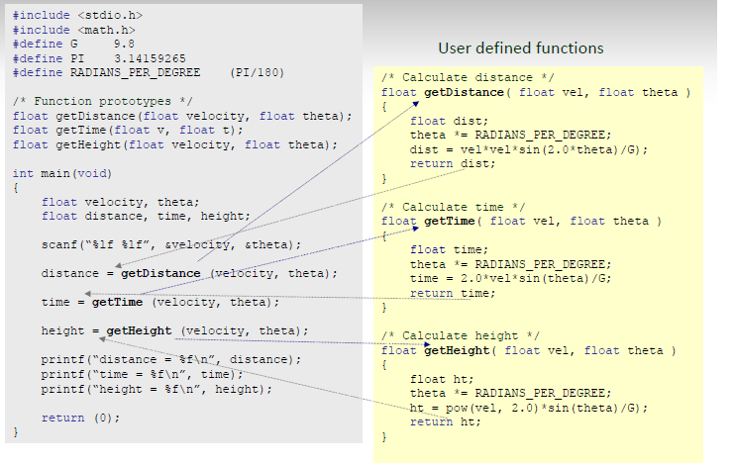

Slide 34
IV. Case study: Integer Digits
Print the least significant digit of an integer entered from the keyboard
Example:
24 -> 4
138 -> 8
One of the key questions that you should answer: How many functions do I need?
main
enter an integer
extract the first digit
print the first digit
scanf(…)
getFirstDigit(…)
printf(…)

Slide 35

Example
/*
* Print the first digit of an integer
*/
#include <stdio.h>
int getFirstDigit( int num ); int main(void)
{
int number, digit; printf(“Enter an integer:”); scanf(“%d”, &number);
digit = getFirstDigit( number );
printf(“The digit is: %d”, digit); return 0;
}
/*
Extracts the least significant
digit of an integer
pre: num – integer
post: the least digit of num
*/
int getFirstDigit( int
{
return (num % 10);
}
num )

Slide 36
Example
Design a program that extracts and adds two least significant digits of an integer
Usually, there are several ways how to split a program into a set of interacting functions
A possible solution
main
input an integer
get first digit
get second digit
get sum of two digits
output

Slide 37


Solution
/*
This program extracts and adds the two least
significant digits of an integer
*/
#include <stdio.h>
/* prototypes */
int getFirstDigit(int num); int getSecondDigit(int num);
int addTwoDigits(int d1, int d2);
int main(void)
{
int number, digit1, digit2, sum;
printf(“Enter an integer: “); scanf(“%d”, &number);
digit1 = getFirstDigit(number); digit2 = getSecondDigit(number);
sum = addTwoDigits(digit1, digit2);
printf(“The sum is %d\n”, sum); return (0);
}
/* first digit of an integer */
int getFirstDigit( int num )
{
return (num%10);
}
/* second digit of an integer*/
int getSecondDigit( int num )
{
return ( (num/10)%10 );
}
/* Sum of two digits */
int addTwoDigits( int
{
return (d1+d2);
d1, int d2 )
}

Slide 38


IV. Common Errors
/* the function prototype */
double divide( int dividend, int divisor );
…
/* the double
{
. . .
}
function definition */
divide(
float dividend, float divisor)
Type mismatch
/* the function prototype */
double divide( float dividend, float divisor );
…
/* the double
{
. . .
}
function definition */ divide( float dividend )
Mismatch in the number of parameters
Easy to find and fix as these errors are detected by the compiler

Slide 39


Common Errors
double divide(
… double
{
float
dividend, float divisor );
Incorrect order
( Not detected by the compiler)
divide(
float
divisor, float dividend )
. . .
}
double divide( float
…
double divide( float
{
dividend,
float
divisor);
A local variable is declared with the same name as a parameter
(Detected by the compiler)
dividend,
float
divisor)
float dividend;
. . .
return result;
}

Slide 40
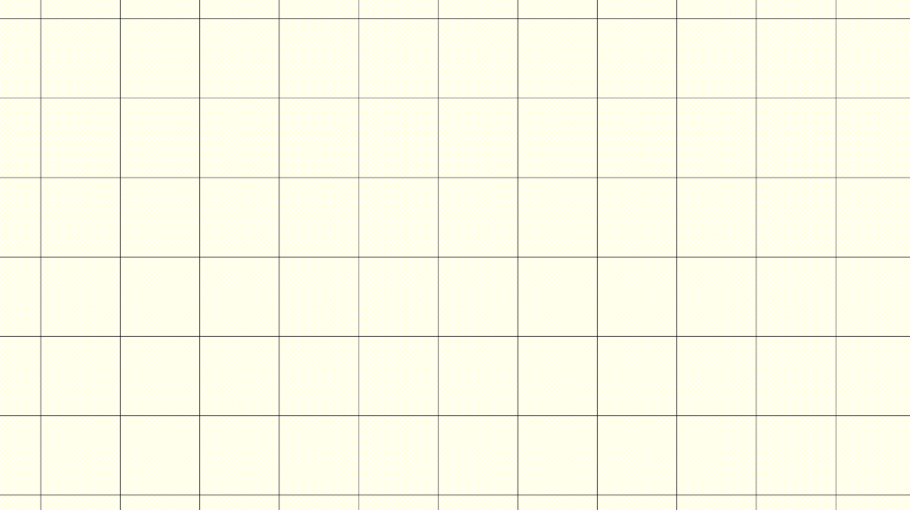
Common Errors
float divide(float dividend, float divisor);
…
int main(void)
{
float dividend, divisor, res;
… …
res = divide(dividend, divisor);
}
float divide(float dividend, float divisor)
{
float result;
. . .
return;
}
No value is returned, while float is expected
( Warning issued by most compilers )

Slide 41
Common Errors
float divide(float dividend,
…
int main(void)
{
float dividend, divisor,
… …
float divisor);
Insufficient number of actual parameters
( detected by the compiler )
res;
res = divide( dividend ); /* two parameters
should
be passed */
}
float divide(float
{
float result;
. . .
return result;
dividend,
float
divisor)
}

Slide 42
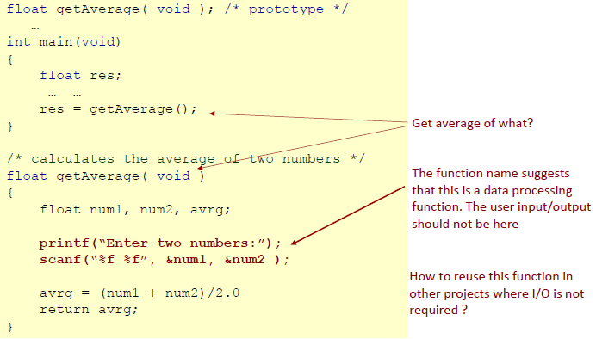
Bad Structuring

Slide 43
A Better Solution
float getAverage( float par1, float
…
par2 );
int main(void)
{
float num1, num2, res;
printf(“Enter two numbers:”); scanf(“%f %f”, &num1, &num2 );
. . .
res = getAverage( num1, num2 );
}
User input (if it’s needed at all) can be moved to the top level function, or to another function responsible exclusively for user input of numbers
/* calculates the average of two numbers */ float getAverage( float par1, float par2 )
{
float avrg;
avrg = (par1 + par2)/2.0; return avrg;
}

Slide 44
Programming Style
/* -----------------------------------------------
* Description of the function
*
*
*
Parameters: valid input parameters
Returned value: description on the return value
-------------------------------------------------*/
retutn_type functionName( list of formal parameters )
{
/* local variables */
. . .
/* | block | of executable | statements | */
. | . .
}

